Slide 1
Cooperative Diversity
Caleb Zulawski
Spencer Chan

Slide 2
Cooperative Schemes
Autonomous self-organizing networks:
Wireless ad-hoc networks
Wireless sensor networks
Requires nodes to relay data for other nodes when available
Reasons for implementation:
Transmit longer distances with less power
Transmit with diversity gain to combat multipath/shadow fading

Slide 3
Direct Scheme
D
Data is transmitted from the source node to the destination node.
Destination responds with an ACK if the checksum matches the packet, or with a NACK otherwise.
1
Packet + CRC
ACK
2
S
3

Slide 4
Relay Scheme (Cooperative)
D
The source sends data to an intermediate node, which relays the data to the destination.
1
Packet + CRC
ACK
2
Packet + CRC
ACK
S
ACK
3

Slide 5
Cooperative Diversity Scheme
D
Diversity = 2
If the direct scheme fails, the packets are sent to nodes, which are used as multiple antennas to produce diversity gain.
Potential relays are chosen by those which receive a correct CRC and packet.
1
Packet + CRC
NACK
ACK
Packet + CRC
NACK
Packet + CRC
2
Packet + CRC
NACK
Packet + CRC
S
3
ACK

Slide 6
Adaptive Cooperative Diversity
An adaptive scheme can choose which scheme to use depending on channel state.
Goal is to maximize quality of service

Slide 7
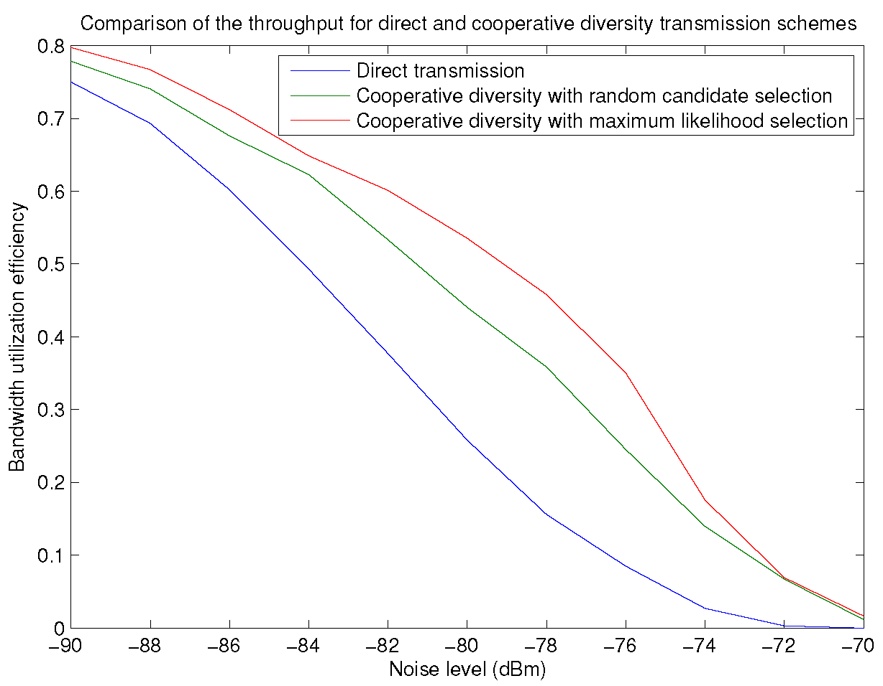
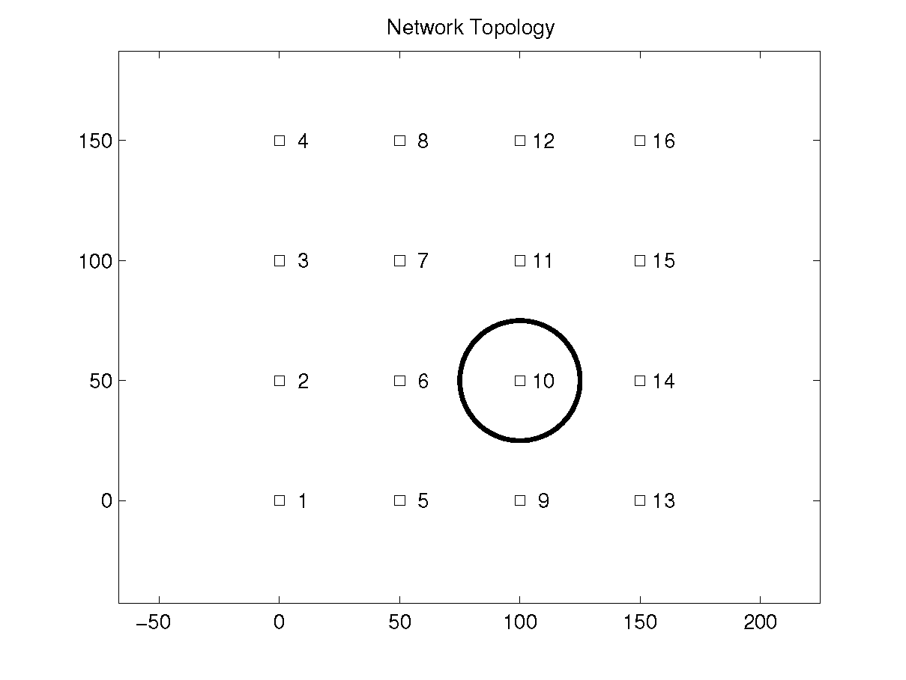

Slide 8
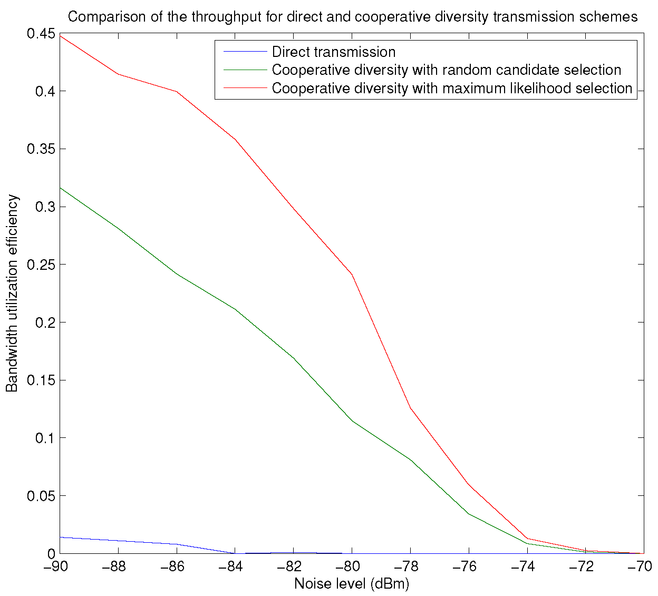
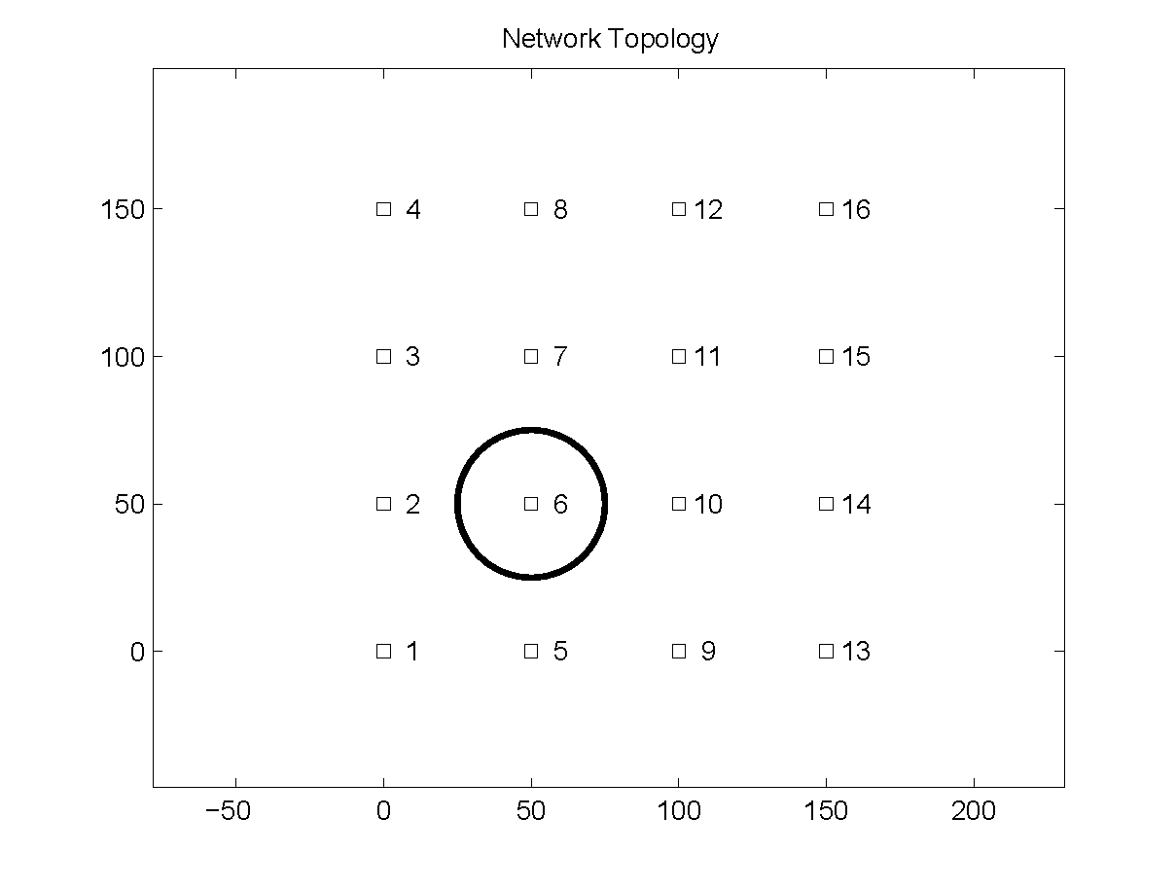

Slide 9
Sources
L. Dai and K. B. Letaief. “Throughput Maximization of Ad-hoc Wireless Networks Using Adaptive Cooperative Diversity and Truncated ARQ.”
S. S. Ikki and M. H. Ahmed. “Performance Analysis of Cooperative Diversity with Incremental-Best-Relay Technique over Rayleigh Fading Channels.”

